Slide 1
Creating Valuations for Multifamily Buildings in Manhattan
Avidan Berman

Slide 2
Overview
01
What Tools were used in this Project
02
How Real Estate Professionals Perform Valuations
03
Exploring the Data
04
The Model and its Applications
05
Future Works

Slide 3






Python Libraries
These libraries were used to handle the data pulled from NYC.gov

Slide 4
How do Real Estate Brokers Valuate Properties
Find the buildings NOI
NOI= Gross Profit - Operating expenses (including tax and excluding mortgage)
Find the Cap Rate
Cap Rate is the expected rate of return on a property. In Manhattan that is generally 5%
Plug your numbers into the formula
NOI/Cap Rate= Building Value

Slide 5
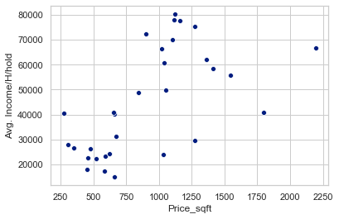
Are area’s with a higher average family income more expensive
Positive correlation between Average Household Income and Price per Square Foot
While the price/sqft goes up the size of the actual apartments don’t go up.

Slide 6
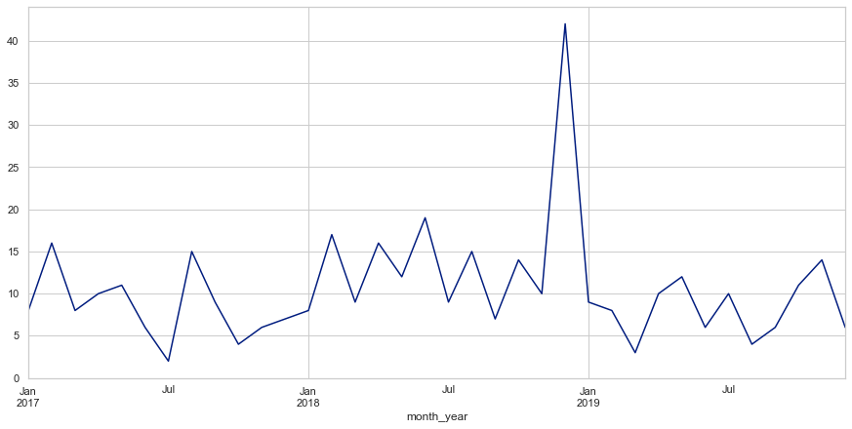
Housing Stability and Tenant Protection Act
Passed in July of 2019
When passed owners thought would be catastrophic
It had a negative immediate effect on the market but stayed right around the year average

Slide 7
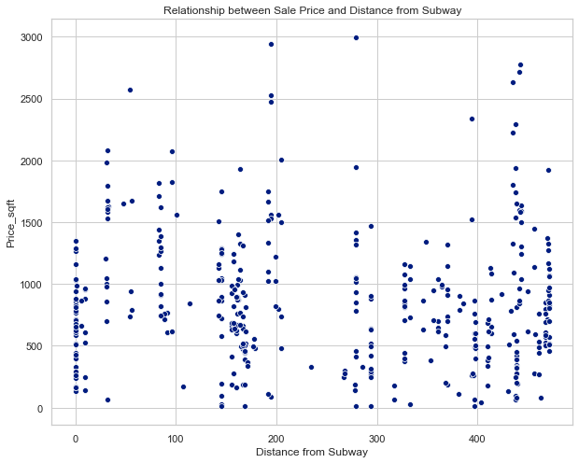
Does the Distance from Subway’s Effect Building Prices
Negative Correlation
Weak Relationship
We would have thought it was better considering its a factor in where people look to rent

Slide 8
Prediction Model
Real Estate Professionals:
Best Model
Real Estate Professionals claim that their valuations are within 5% of actual sale price
Lasso model that didn’t include the building age or distance from subway
Models Used
Just how close was the model?
I tested multiple models using the Train Test Split Model and the Lasso Model
On average the model came within about $1mm of the actual price.

Slide 9

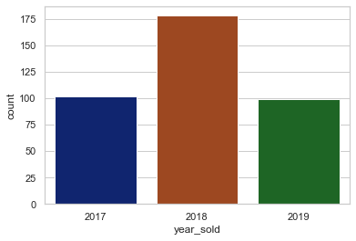
Success or Failure?
Who is this good for?
Moderate success but can still improve
Zillow Est. for Owners and Off-market buyers
Next Steps:
- Get average rent data for zip codes
- Create a function that automatically pulls all the data based on address
- Web scrape building information (bedrooms/bathrooms)

Slide 10
Thank you

